Slide 1

Bluetooth LE fingerprinting
McCullough, Lukas
Munger, Ryan
Tyler, Patrick
Foti, Dominick

Slide 2
Table of Contents
What is Bluetooth Low Energy?
Background/Previous Publications
Data Collection
Data Analysis
Findings
Challenges
Next Steps

Slide 3
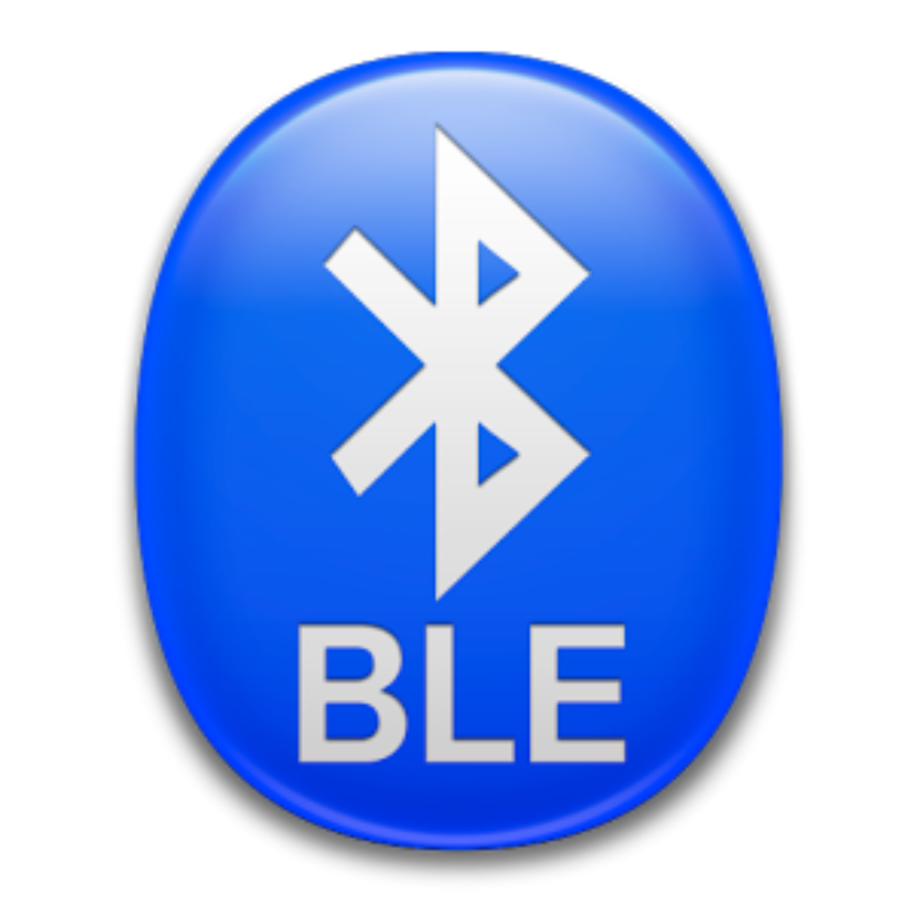
Bluetooth Low Energy, What is it?
Wireless Personal Area Network Technology made by the Bluetooth Special Interest Group
Features:
  Low power consumption
  Compatibility
  Long range
Common devices that utilize BLE technology
  Wireless earbuds
  Pacemakers
  Tire pressure sensors
  Smartwatches

Slide 4
Previous Work & Publications

Slide 5
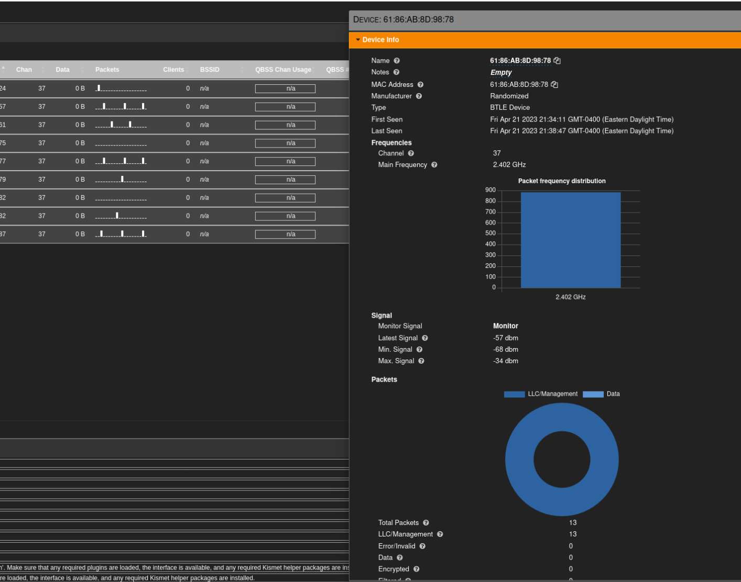
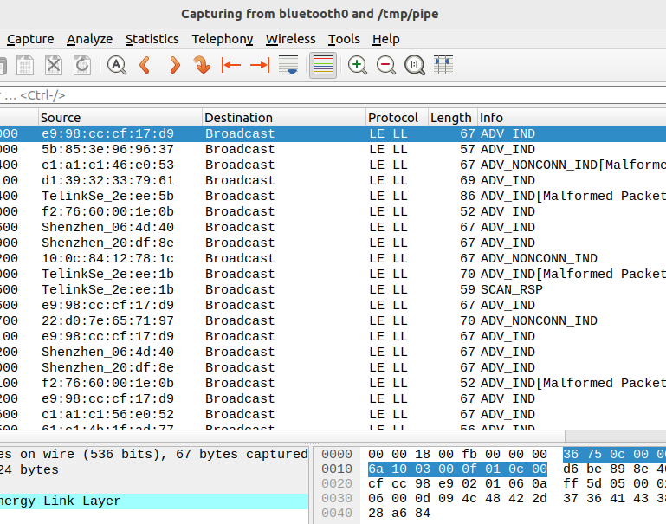
Spring 2023:
Device data capture with Kismet / Wireshark
Wireshark: stream of live data, all data readily available
Kismet: clean dashboard with statistics and overall data, non-scrolling feed
Investigated the attributes we can capture
Notes:
In previous semesters, our work first began with finding out what the actual work should look like. We needed to see what data could be gathered from BLE transmissions, and what we could identify based on that information.
Spring 2023 was devoted to conducting numerous scans utilizing different software and hardware, and deciding on what would provide the best results for future testing. We used kismet and wireshark to view data captured by an ubertooth dongle attached to a laptop
After we had a better idea on what we needed to complete, we were able to hone in on what tools could provide the best success.

Slide 6
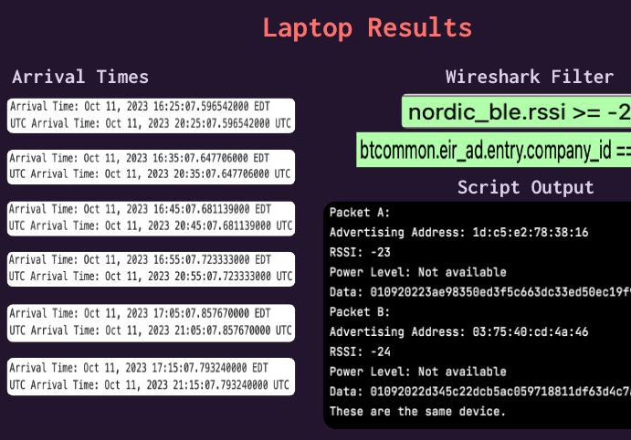
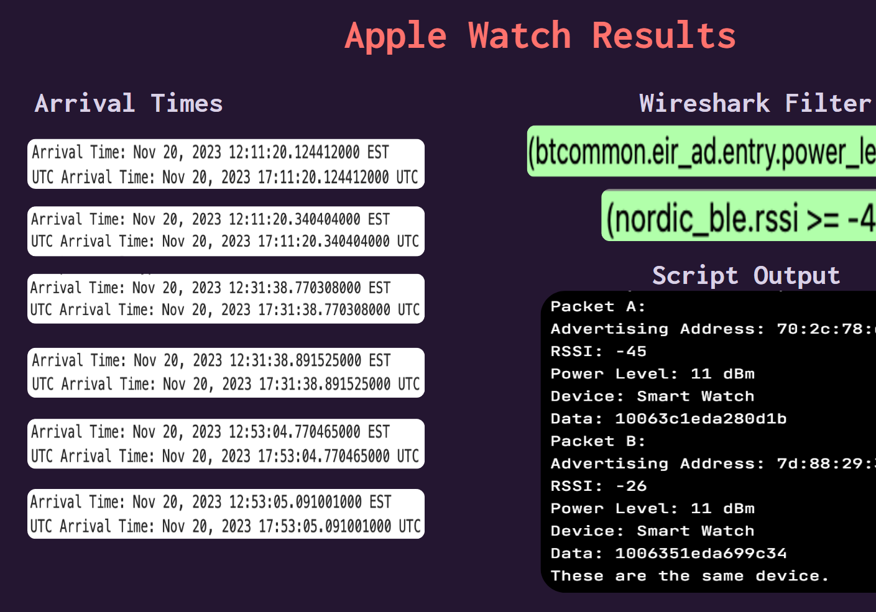
Fall 2023:
Parsing device data & First attempt at device identification
Apple watch:
  Fingerprinted with RSSI and power level
Laptop:
  Fingerprinted by company ID attribute and RSSI
Limitations:
  Signal strength varies as device moves
  Only two attributes of analysis
Notes:
For Fall 2023, we had taken scans done in the previous semester, along with new ones, and began comparing packets and their contents. We found 2 notable attributes that could be used to narrow down the type of device. They included rssi and power level. RSSI helped us find out the proximity of the device, and power level indicates how much transmit power a device has, potentially indicating the type of device.

Slide 7
Related Works:
The University of Edinburgh: Anatomy of a Vulnerable Fitness Tracking System: Dissecting the Fitbit Cloud, App, and Firmware, 2018
  Exposed encryption keys via BLE exploit
Yue Zhang: Breaking Secure Pairing of Bluetooth Low Energy Using Downgrade Attacks, 2020
  BLE has vulnerabilities that allow for lateral movement
Champlain College: Bluetooth Tracking, 2018
  Findings suggest that Bluetooth scanning may not be precise/reproduceable
Notes:
the related publications I have listed show the relevance of our work.

Slide 8
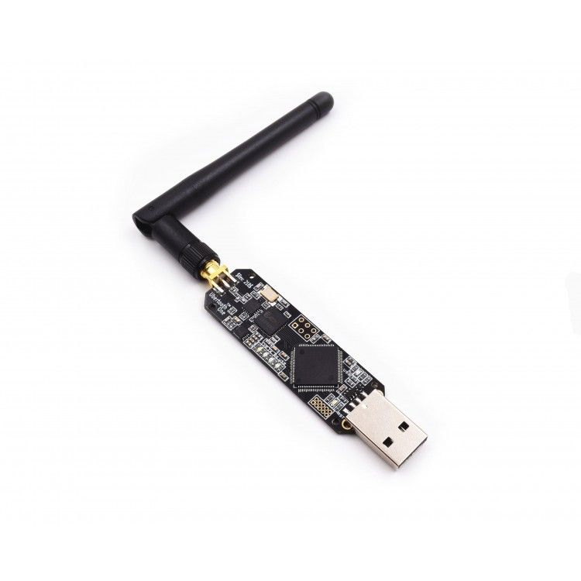
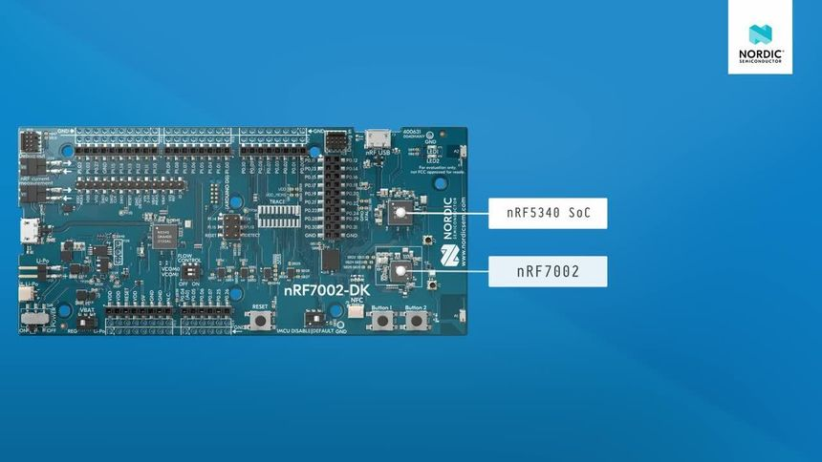
Data Collection
Ubertooth1 vs NordicRF52840 BLE
  RSSI, Power Level, and more!
  Deprecation, power supply
Isolation
  Necessary to detect a MAC transition
Observing Behavior Patterns
  How often does a device advertise/randomize?
Notes:
Used ubertooth first, but this needs VM and collects less detailed data
Isolation is needed due to high traffic and observing change
Nordic can artificially isolate
With these captures we can see when devices change, how often, broadcast tendencies, etc

Slide 9

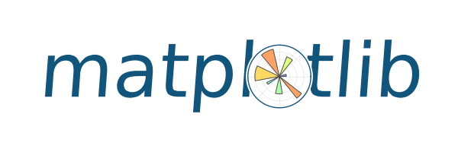
Data Analysis
Programmatically determine advertising address changes
Differentiate massive amounts of packets
  Using captured data attributes
  MAC, time, RSSI, Power Level, Company ID
Parse captured packets to Python objects
  Pyshark
Graphically display address changes
  Matplotlib
Notes:
Company ID is similar to OUID.

Slide 10
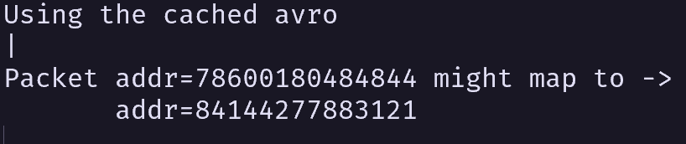
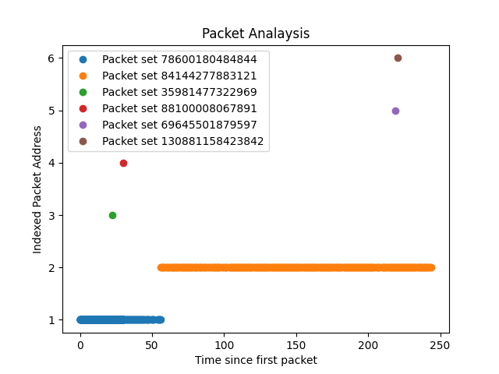
Findings
Focus on last and first packets of address
Graphical output validates text output
Confidence on address's average delay between packets

Slide 11
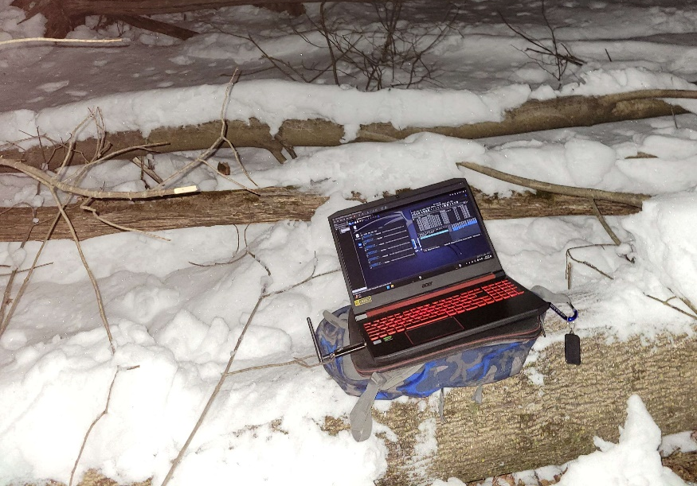
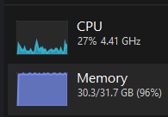

Challenges
Busy Airwaves – Large Captures!
  45 minutes; 3,000,000 Packets!
Isolated Captures
  Diminished Battery Life
Processing & Memory
  Python can be inefficient – cache calculations!
  How to store this cache: Apache Avro
Notes:
Discuss capture sizes, why we had to go remote: everything has BLE!
Once we went remote: ble dongles suck power, its cold, VM with ubertooth
Apache avro is serialized (converts data to objects such as avro’s custom binary format that is easy to store) and it’s encoding is compact, taking up less space.
Can load avro data in chunks instead of whole file.
Avro uses custom schemas.
Avro is interoperable so any code we write can interact with our data

Slide 12
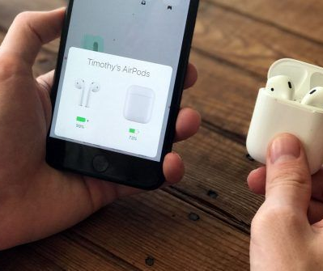

Next Steps
Improve processing efficiency and portability
  Embedded programming with Zig
Track devices over time
Develop an IDS
  Unpermitted device
  Anomalous Behavior
Make Privacy Recommendations
  Turn Bluetooth off
  Do not advertise manufacturer ID

